Slide 1
Event Seating and Parking Management (ESPM)
Group B
Atharva, Maryada, Poonam, Rajas
December 10, 2022

Slide 2
Executive Summary
A smart system to solve the parking problems at big events by creating database and adding parking related entities that will allow to reserve a parking spot along with seat in advance while booking the ticket.
Agenda
Data collection
Data preparation
ERD- assumptions and cardinalities
Relational schema mapping
Database creation
Business question
Visualizations
Deployment and lessons learned
Problem statement
Time inefficient
Slow process due to pay-to-park
Paper tickets lost
Manpower

Slide 3
Assumptions
Parking lots are always provided at the event location
Every event has unique ID- both home and away matches
A coach can only belong to one team- a team can have multiple coaches.
Unique combination of event id and ticket number for every location
Every parking area has different lot and slot numbers.

Slide 4
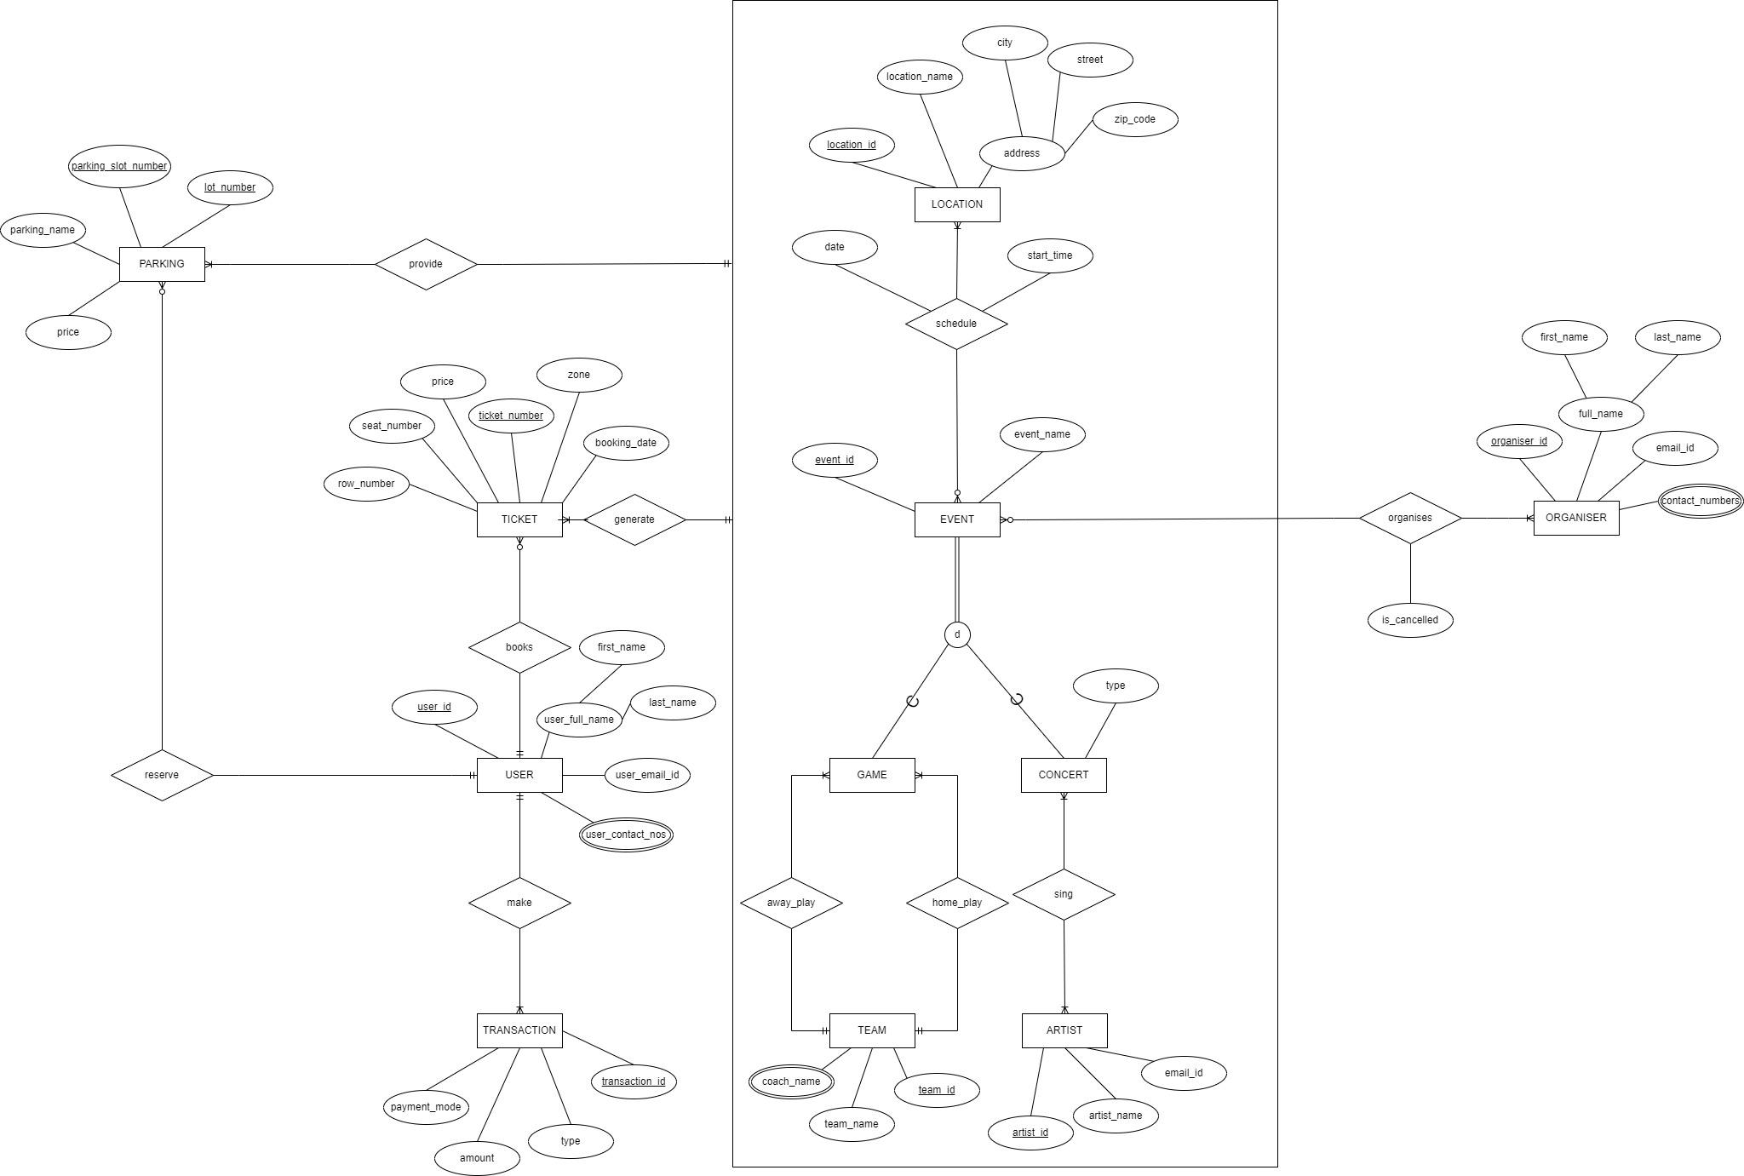
Entity Relationship Diagram

Slide 5
Cardinalities
An event at a location provides one or many parking spots.
One Parking spot can be reserved for one event at a location only.
An event can be a game event or a concert.
A team can play one or many games at home.
A team can play one or many games away from home.
A game can be played by one home team only.
A game can be played by one away team only.
A concert can have one or many artists.
An artist can sing at one or many concerts.
An event can be organized by one or many organizers.
An organizer can organize no or many events.
An event at a location generates one or many tickets.
A ticket belongs to one and only one event at a location.
A ticket can belong to one user only.
A user books one or many tickets.
A user makes one or more transactions.
A transaction can be made by one user only.
Parking can be reserved by one user only.
A user can reserve no or many parking spots.
An event can be scheduled at one or more locations.
A location can have no or many events.

Slide 6
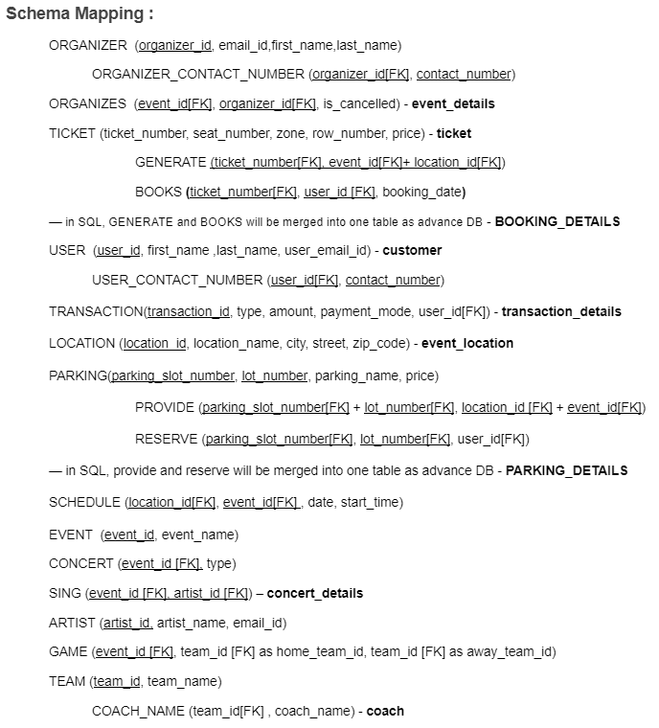
Relational schema mapping

Slide 7
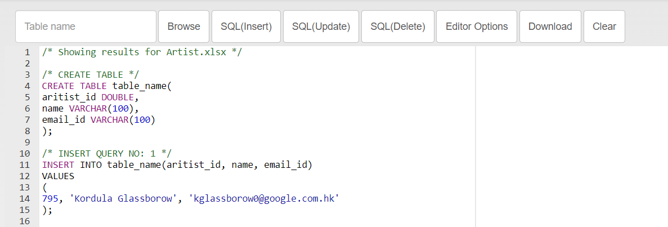
Data source
Generated random data from mockaroo.com
Used SQLizer and BeautifyTools to convert excel to base SQL queries.

Slide 8
Database Queries
CREATION OF DATABASE
CREATE DATABASE event_management;
CREATION OF TABLES
CREATE TABLE if not exists booking_details(
ticket_number VARCHAR(100),
event_id VARCHAR(100),
location_id VARCHAR(100),
user_id VARCHAR(100),
booking_date DATE,
foreign key(ticket_number) references ticket(ticket_number),
foreign key(location_id,event_id) REFERENCES schedule(location_id,event_id),
foreign key(user_id) references customer(user_id),
primary key(ticket_number,location_id,event_id));
INSERTION OF VALUES INTO THE TABLES
INSERT INTO organizer(organizer_id, first_name, last_name, email_id)
VALUES('48-8667073', 'Lydie', 'Raiker', 'lraiker0@kickstarter.com');

Slide 9
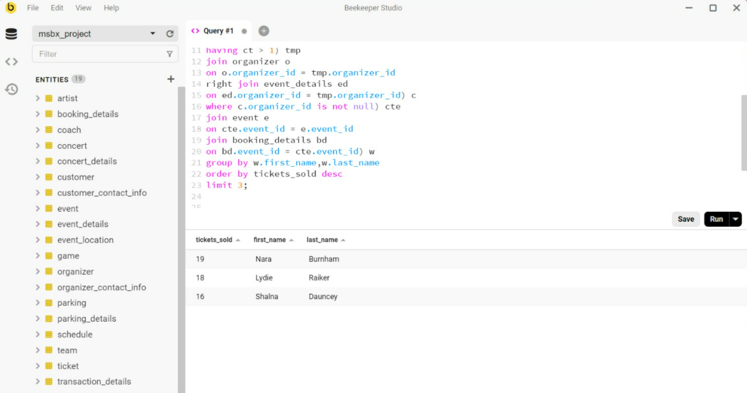
Business Questions Queries
Display the top 3 organizers in terms of :-
a) no of events organized.
b) the maximum number of tickets sold for an event.
select count(*) tickets_sold,w.first_name,w.last_name
from (select cte.organizer_id, cte.first_name, cte.last_name, cte.event_id, e.name,bd.user_id
from (select * from (select tmp.organizer_id,o.first_name,o.last_name, ed.event_id
from (select organizer_id, count(*) ct
from event_details
where is_canceled = 0
group by organizer_id
having ct > 1) tmp
join organizer o
on o.organizer_id = tmp.organizer_id
right join event_details ed
on ed.organizer_id = tmp.organizer_id) c
where c.organizer_id is not null) cte
join event e
on cte.event_id = e.event_id
join booking_details bd
on bd.event_id = cte.event_id) w
group by w.first_name,w.last_name
order by tickets_sold desc
limit 3;

Slide 10
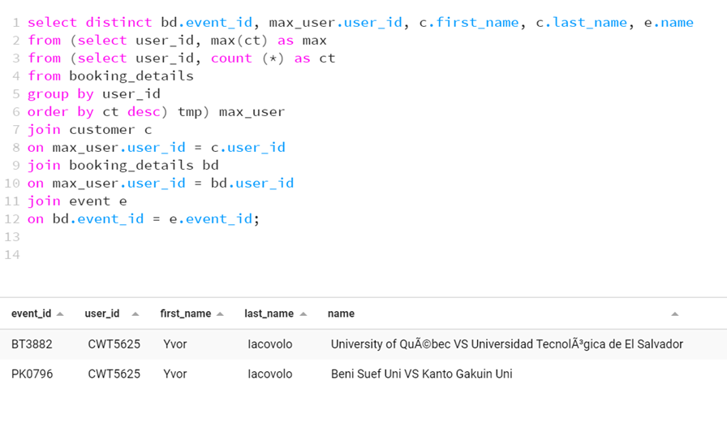
Display the event name, event id, user id, first name, and last name of the user who has booked the maximum number of tickets.
select distinct bd.event_id, max_user.user_id, c.first_name, c.last_name, e.name from (select user_id, max(ct) as max
from (select user_id, count(*) as ct
from booking_details
group by user_id
order by ct desc) tmp) max_user
join customer c
on max_user.user_id = c.user_id
join booking_details bd
on max_user.user_id = bd.user_id
join event e
on bd.event_id = e.event_id;

Slide 11
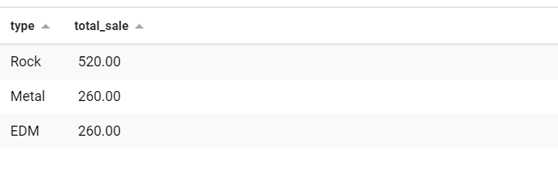
Display the concert with its Genre/Type that generated the maximum revenue.
select tmp.type, sum(t.price) total_sale
from (select c.type,bd.ticket_number
from concert c
inner join booking_details bd
on c.event_id = bd.event_id) tmp
join ticket t
on tmp.ticket_number = t.ticket_number
group by tmp.type
order by total_sale desc;

Slide 12
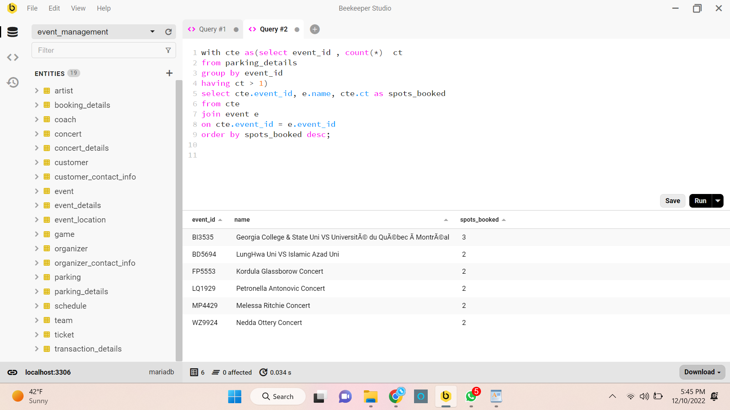
Display the event name, event id for which the most number of parking spots were booked.
with cte as(select event_id , count(*) ct
from parking_details
group by event_id
having ct > 1)
select cte.event_id, e.name, cte.ct as spots_booked
from cte
join event e
on cte.event_id = e.event_id
order by spots_booked desc;

Slide 13
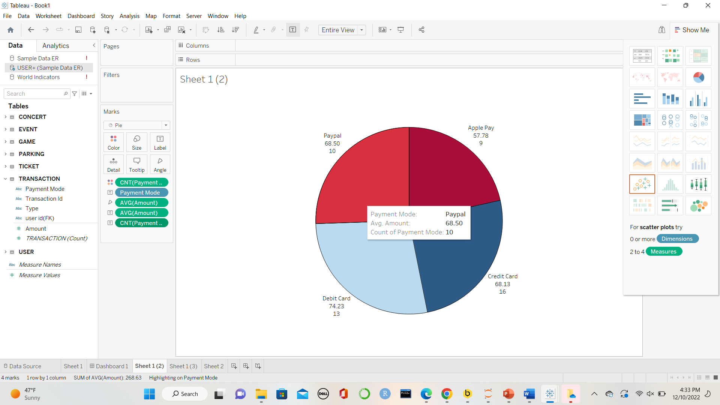
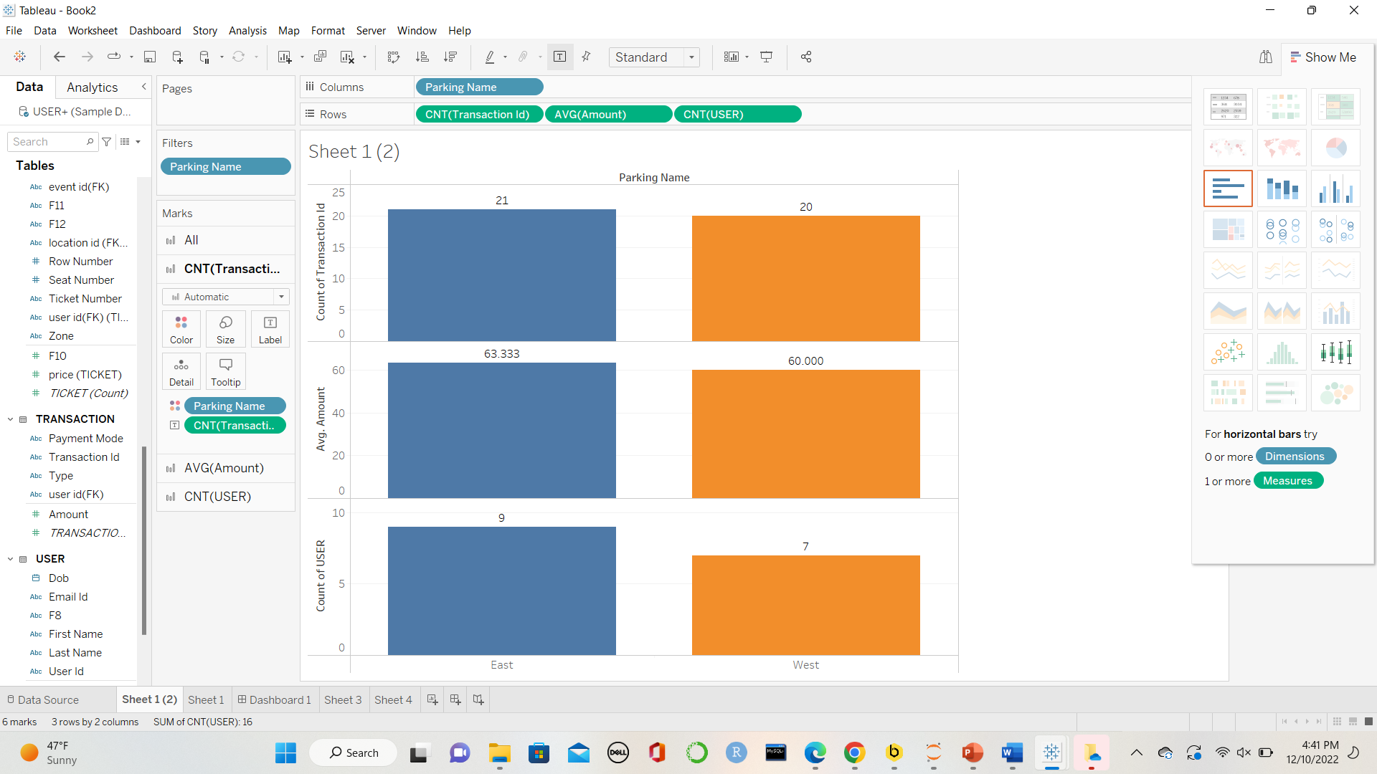
Visualizations
Viz(b): Stacked Bar charts of various attributes by Parking Names
Viz(a) : Pie Chart of Payment Modes

Slide 14
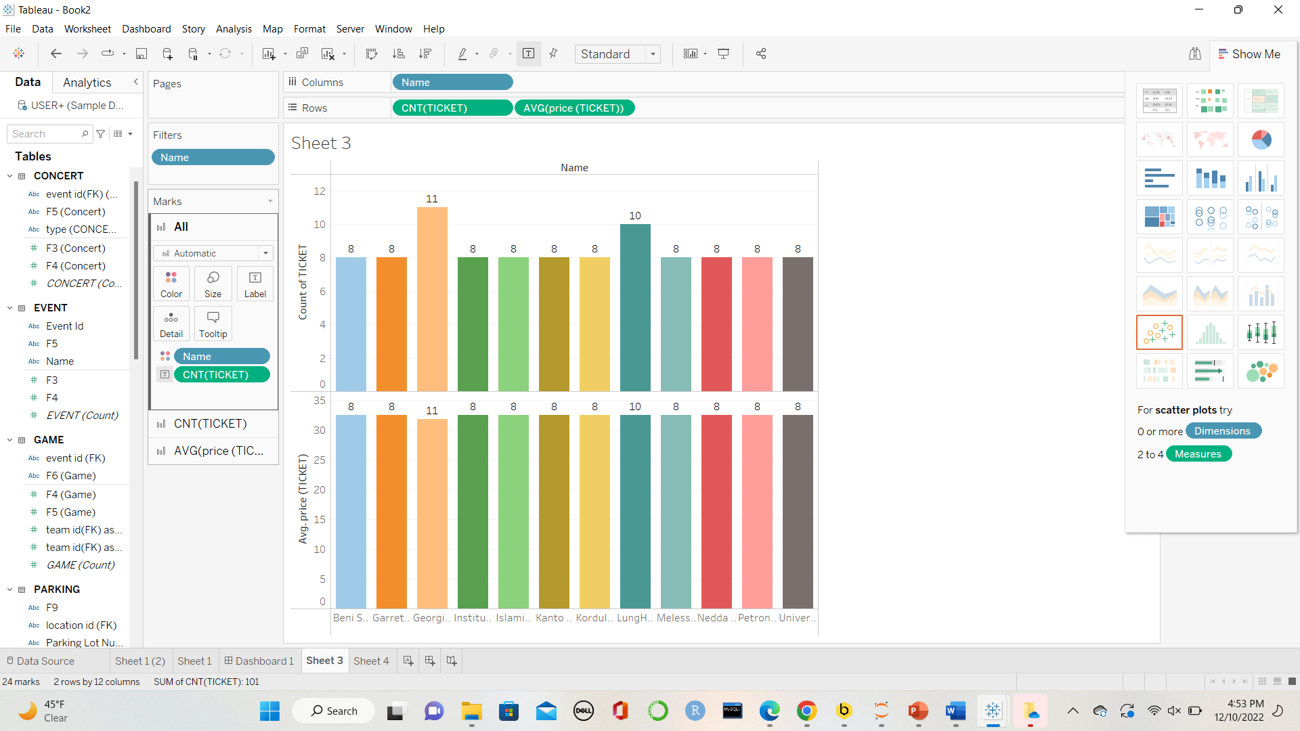
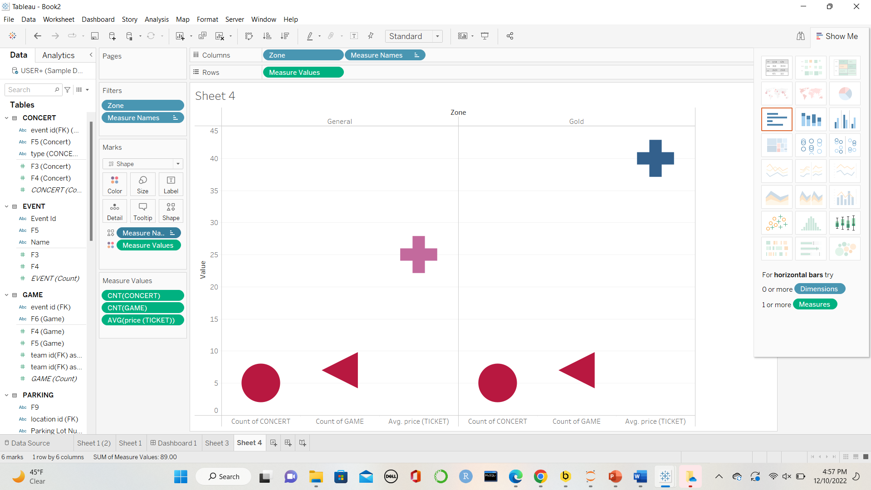
Visualizations
Viz(c): Bar Charts for Avg Ticket Price and No. of Tickets by Event Names.
Viz(d): Charts for different values of Ticket types

Slide 15
Deployment and Problems Faced
Deployment of ESPM in real world will benefit event organizers and attendees as:
Improve revenue management
One time cost for long term benefit
Traffic congestion
Provide visibility of overall facility
No hassle of arriving early to find parking
Problems Faced
ERD needed to be updated (added aggregation) due to confusion between seat ticket and parking ticket.

Slide 16
Thank you !

